Slide 1
gPCD Data Analysis
Best Fit Trendlines and Analysis

Slide 2
Table of Contents
Summary
Graphics Pipeline Reports
Compute Pipeline Reports (tbd)
Total Time Reports (tbd)
All Plots
Q-Q Plot

Slide 3
Performance Analysis
Summary of interpretation
The data being analyzed is the time to detect collisions while the number of particles and collisions grow. The collisions are always half of the number of particles so that they grow linearly with the number of particles.
Data interpolation is for comparative analysis. Specifically, how the algorithm compares to a generally equivalent quadratic or linear time algorithm with the same base cost.
The data is based on the maximum frames per second (minimum seconds per frame) which makes smooth data difficult.
It is probably not possible to get an exact data fit for the frame times because the GPU makes decisions based on the commands, configuration, size of the data, and thermal condition.

Slide 4
Performance Analysis
Summary of interpretation
The data being analyzed is the time to detect collisions while the number of particles and collisions grow. The collisions are always half of the number of particles so that they grow linearly with the number of particles.
The GPU performance profile has a number of outliers and dramatic change occurs around 7E5 particles where it then settles into a more linear trend.
The data is heteroscedastic so that variation in time grows as the time scale grows. A log plot was performed to remove scale variations. It showed that that the time variation does grow in direct proportion to the number of particles.

Slide 5
Performance Analysis
Summary of interpretation
The data being analyzed is the time to detect collisions while the number of particles and collisions grow. The collisions are always half of the number of particles so that they grow linearly with the number of particles.
Total time is the sum of the graphics and compute pipeline processing time. O(N + M)
The theoretical complexity of total time is known to be O(n²).
A very small base cost per frame (bcpf) (K) puts a tiny interval very close to the minima of the fit function such that it is essentially linear. The trendlines must be considered “as if and only on this interval” or ‘if there were a competing algorithm with this base cost, and this interval, what would it look like?”.
The degree of parallelization can grow to a point where there is an effective reduction of order from the original complexity (in this case O(n²)) to a linear one (O(n) in this case).

Slide 6
Grpahics Performance Analysis
Summary of interpretation
The data being analyzed is the time to detect collisions while the number of particles and collisions grow. The collisions are always half of the number of particles so that they grow linearly with the number of particles.
A competing quadratic algorithm for the frame time of the graphics pipeline, has a base cost of 6.6453E-19 (s) where x is the number of particles and t(s) is the time to process one frame (t = 3E-18x² + 1E-09x - 6E-05, R² = 0.9917.
A competing linear algorithm for the frame time of the graphics pipeline, has a base cost of 1.3624E-09(s) where x is the number of particles and t(s) is the time to process one frame t = 1.3624E-09x - 7.4949E-05, R² = 9.9188E-01

Slide 7
Performance Analysis
Summary of interpretation
The data being analyzed is the time to detect collisions while the number of particles and collisions grow. The collisions are always half of the number of particles so that they grow linearly with the number of particles.
A competing quadratic algorithm for the frame time of the compute pipeline, has a base cost of 5.3656E-18 (s) where x is the number of particles and t(s) is the time to process one frame (t = 5.3656E-18x² + 6.5170E-09x - 2.1597E-04, R² = 9.9977E-01).
A competing linear algorithm for the frame time of the compute pipeline, has a base cost of 6.5582E-09 (s) where x is the number of particles and t(s) is the time to process one frame t = 6.5582E-09x - 2.5284E-04, R² = 9.9977E-01

Slide 8
Performance Analysis All
Summary of interpretation
The data being analyzed is the time to detect collisions while the number of particles and collisions grow. The collisions are always half of the number of particles so that they grow linearly with the number of particles.
When comparing graphics and compute performance, the compute consumes most of the time and grows at a rate greater than does graphics.
A competing linear algorithm for the frame time of the compute pipeline, has a base cost of 6.5582E-09 (s) where x is the number of particles and t(s) is the time to process one frame t = 6.5582E-09x - 2.5284E-04, R² = 9.9977E-01

Slide 9
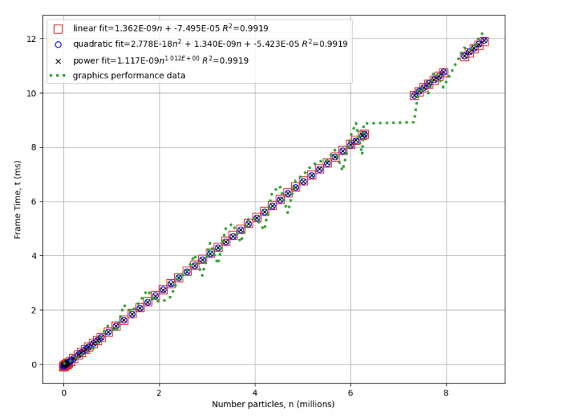
The Graphics Pipeline
Performance data interpretation

Slide 10
Graphics Pipeline Total Frame Time (spf)
Polynomial Fit
The quadratic trendline for the graphics pipeline. A completing algorithm has a K=2.6135E-18 which is essentially zero.

Slide 11
Graphics Pipeline Total Frame Time (spf)
Polynomial Fit
The residuals of the quadratic fit showing the mean in orange the data is fairly random around the mean while increasing with increasing time and number of particles.

Slide 12
Graphics Pipeline Total Frame Time (spf)
Polynomial Fit
The percentage error is less than 20% after approximately 1.5 million particles and falls to less than ten percent after 5 million.

Slide 13
Graphics Pipeline Total Frame Time (spf)
Linear Fit
The linear trendline for the graphics pipeline. A completing algorithm has a base cost of 1.3624E-09 (s)

Slide 14
Graphics Pipeline Total Frame Time (spf)
Linear Fit
The residuals of the linear fit showing the mean in orange.

Slide 15
Graphics Pipeline Total Frame Time (spf)
Log plot
A log₁₀ plot of graphics pipeline performance data. This is done to remove the heteroscedasticity.

Slide 16
Graphics Pipeline Total Frame Time Residuals Log plot
A plot of the log data residuals which shows the residuals decreasing as the number of particles grow and no particular pattern. When corrected for heteroscedasticity the residuals shrink implying that the fit gets better as the number of particles processed increases.

Slide 17
Graphics Pipeline Total Frame Time Residuals Log plot
A plot of the percentage error in log data residuals which shows the residuals decreasing as the number of particles grow and no particular pattern. Errors are less than 8 percent after 600,00 particles.

Slide 18
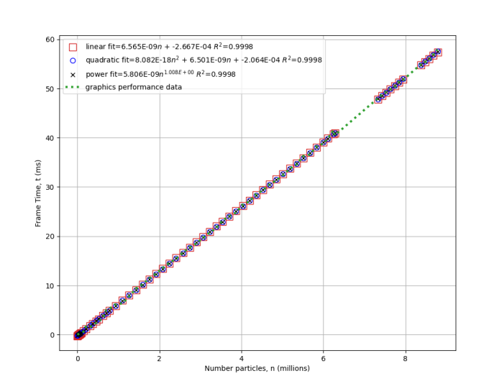
The Compute Pipeline
Performance data interpretation

Slide 19
Compute Pipeline Total Frame Time (spf)
Polynomial Fit
The quadratic trendline for the compute pipeline. A completing algorithm has a K=2.7785E-18 which is essentially zero.

Slide 20
Compute Pipeline Total Frame Time (spf)
Polynomial Fit
The residuals of the compute quadratic fit showing the mean in orange the data is fairly random around the mean while increasing with increasing time and number of particles.

Slide 21
Compute Pipeline Total Frame Time (spf)
Linear Fit
The linear trendline for the compute pipeline. A completing algorithm has a base cost of 1.3624E-09 (s)

Slide 22
Compute Pipeline Total Frame Time (spf)
Linear Fit
The residuals of the linear fit showing the mean in orange.

Slide 23
Compute Pipeline Total Frame Time (spf)
Log plot
A log₁₀ plot of compute pipeline performance data. This is done to remove the heteroscedasticity.

Slide 24
Compute Pipeline Total Frame Time Residuals Log plot
A plot of the log compute data residuals which shows the residuals decreasing as the number of particles grow and no particular pattern. When corrected for heteroscedasticity the residuals shrink implying that the fit gets better as the number of particles processed increases.

Slide 25
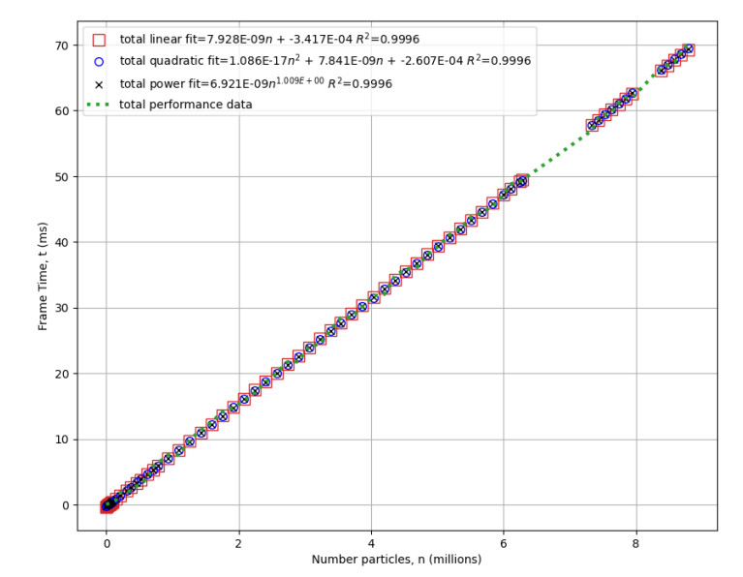
Total Time (Graphics +Compute)
Performance data interpretation

Slide 26
Total Pipeline Total Frame Time (spf)
Polynomial Fit
The quadratic trendline for the compute pipeline. A completing algorithm has a K=2.7785E-18 which is essentially zero.

Slide 27
Total Pipeline Total Frame Time (spf)
Polynomial Fit
The residuals of the compute quadratic fit showing the mean in orange the data is fairly random around the mean while increasing with increasing time and number of particles.

Slide 28
Total Pipeline Total Frame Time (spf)
Linear Fit
The linear trendline for the compute pipeline. A completing algorithm has a base cost of 1.3624E-09 (s)

Slide 29
Total Pipeline Total Frame Time (spf)
Linear Fit
The residuals of the linear fit showing the mean in orange.

Slide 30
Total Pipeline Total Frame Time (spf)
Log plot
A log₁₀ plot of compute pipeline performance data. This is done to remove the heteroscedasticity.

Slide 31
Total Pipeline Total Frame Time Residuals Log plot
A plot of the log compute data residuals which shows the residuals decreasing as the number of particles grow and no particular pattern. When corrected for heteroscedasticity the residuals shrink implying that the fit gets better as the number of particles processed increases.

Slide 32
All Plots Graphics+Compute+Total
Performance data interpretation

Slide 33
All trendlines
A quadratic fit plot of the compute, graphics, and total performance. The compute consumes most of the time and grows at a rate greater than does graphics.

Slide 34
All trendlines
A linear fit plot of the compute, graphics, and total performance. The compute consumes most of the time and grows at a rate greater than does graphics.

Slide 35
All trendlines
A plot of the compute, graphics, and total performance. The compute consumes most of the time and grows at a rate greater than does graphics.

Slide 36
Q-Q Plot for Normal Distribution of Residuals
Performance data interpretation

Slide 37
All trendlines
A Q-Q Plot of the linear fit of the graphics pipeline performance. The S-shape can indicate outliers. A segment that represented a straight line is in orange.

